Slide 1
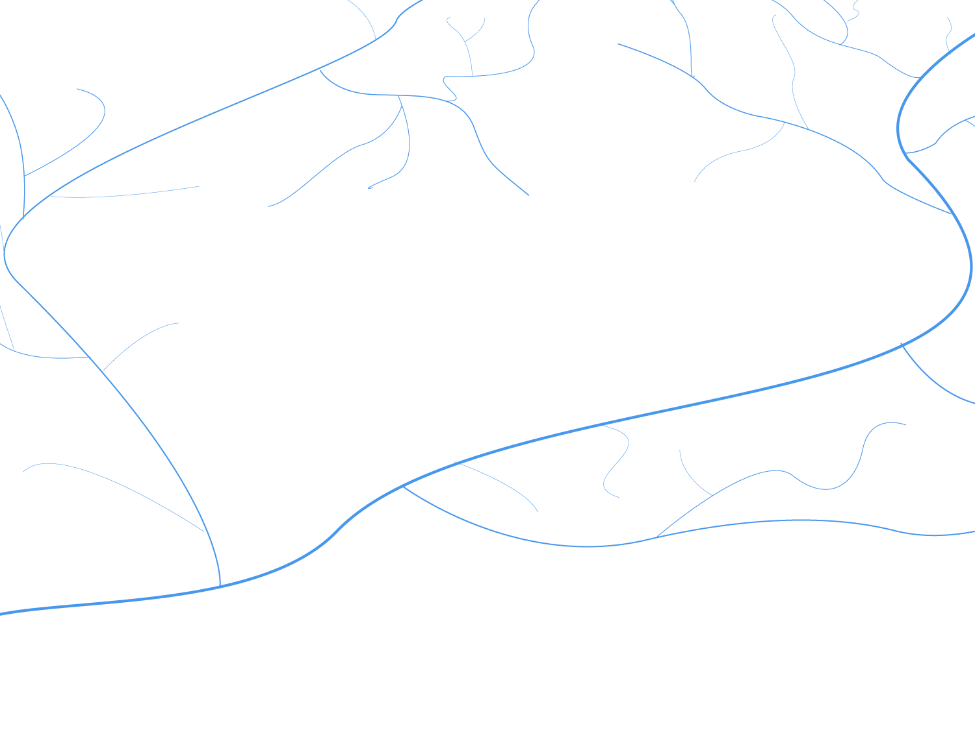





CSP4141 ~ Occupancy Modeling
Model Parameters and Sampling Design

Slide 2
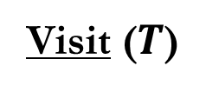
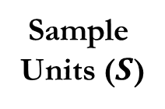
Design of Occupancy Surveys
Study area
(sample frame)
Visit ($T$)
Detected (1)
Undetected (0)
Detected (1)
Sample
Units ($S$)
Undetected (0)
Undetected (0)
Undetected (0)

Slide 3
Design of Occupancy Surveys
Purposes of Sampling
Estimate attributes (parameters)
Occupancy probability
Detection probability.
Enable legitimate extrapolation from data to populations
e.g., Predict occupancy at unsurveyed locations
Provide a measure of statistical reliability.

Slide 4
Design of Occupancy Surveys
Importance of proper survey design
Key properties of estimators:
Bias
Precision: variance and standard error.
Accuracy: combination of bias and precision.

Slide 5
Design of Occupancy Surveys
Bias
How good, on average, is an estimate?
Cannot tell from a single sample
Depends on sampling design, estimator, and assumptions.

Slide 6
Design of Occupancy Surveys
Unbiased
True value
*
Sample estimate
*
*
*
*
*
*
*
Average sample estimate

Slide 7
Design of Occupancy Surveys
Biased
True value
Sample estimate
*
*
*
*
*
*
*
*
BIAS
Average sample estimate

Slide 8
Design of Occupancy Surveys
Repeatable (Precise)
True value
*
Sample estimate
*
*
*
*
*
*
*

Slide 9
Design of Occupancy Surveys
Not Repeatable (Imprecise)
*
True value
*
*
Sample Estimate
*
*
*
*
*

Slide 10
Design of Occupancy Surveys
Can be imprecise but unbiased
*
Average Estimate
*
*
Sample Estimate
*
*
*
*
*
True Value

Slide 11
Design of Occupancy Surveys
Or precisely biased…
True Value
Sample Estimate
*
*
*
*
*
*
*
*
Average Estimate

Slide 12
Design of Occupancy Surveys
Or imprecise and biased…
Average Estimate
*
*
Sample Estimate
*
*
*
*
*
True value
*

Slide 13
Design of Occupancy Surveys
Accurate = Precise and unbiased
True Value
Sample Estimate
*
*
*
*
*
*
*
*
Average Estimate

Slide 14
Design of Occupancy Surveys
Ideally, sampling methods should be…
Accurate – leading to unbiased answers
Repeatable – Estimates lead to similar answers
Efficient – Methods do not waste resources

Slide 15
Design of Occupancy Surveys
How do we make estimates accurate?
Minimize bias
Sample to adequately represent a population
Account for incomplete detection
Minimize variance
Replication (adequate sample size)
Recording of covariates
Stratification

Slide 16
Design of Occupancy Surveys
A well designed study will:
Provide better information
Allow more efficient use of resources
Highlight gaps in current knowledge

Slide 17
Design of Occupancy Surveys
Sample Design Considerations
What is the ‘study area’?
What is a ‘season’?
What is a ‘sampling unit’?
How best to select units for sampling?
How best to conduct repeat surveys?
More sites vs more surveys?

Slide 18
Design of Occupancy Surveys
What is the study area?
Study area = spatial scale at which you would like to make inference about occupancy of the species.
What is the population of interest?
Depends very much on target species and study objectives
Could focus on the known or historic range of the species
Could focus on only a portion of its known range
Is the species migratory?

Slide 19
Design of Occupancy Surveys
What is a “Season”?
A season is a period of time during which it is reasonable to assume occupancy is static or changes occur completely at random.
Depends very much on the target species and study objectives.
Is there a natural definition? (e.g., a breeding season)
How mobile is the species?

Slide 20
Design of Occupancy Surveys
What is an Appropriate “Sampling Unit”?
Sometimes there is a natural definition, such as a patches that can be reliably defined and identified.
Often makes more sense to use pre-defined sample units, such as quadrats, transects, or points.
Ecology of the species matters here, too.
Is it highly territorial?
Does it tend to be associated with very specific habitat types?
What is the size of its home range?

Slide 21
Selecting Sampling Units
Non random placement
Advantages
Easy to lay out
More convenient to sample
Disadvantages
May not represent other habitats
Road may attract or repel
Road

Slide 22
Selecting Sampling Units
Non random placement: Could simply
re-define the study area
Advantages
Easy to lay out
More convenient to sample
Disadvantages
May not represent other habitats
Road may attract or repel
Road

Slide 23
Selecting Sampling Units
random placement
Advantages
Valid statistical design
Represents study area
Replication allows for variance estimation
Disadvantages
May be logistically difficult
Harder to lay out
May not work well in heterogeneous study areas

Slide 24
Selecting Sampling Units
Stratified sampling
Advantages
Controls for heterogeneity
Allows estimation of occupancy by strata
More precise estimate of overall occupancy
Disadvantages
More complex design
May require larger total sample

Slide 25
Design of Occupancy Surveys
Other spatial sampling designs
Systematic sampling
Can approximate random sampling in some cases
Cluster sampling
When the biological units occur in groups
Double sampling
Very useful for detection calibration
Adaptive sampling
More efficient when populations are “patchily” distributed

Slide 26
Selecting Sampling Units
How units are selected determines how results can be generalized.
Each sampling unit within the population should have a non-zero probability of being selected.
If units are selected such that occupancy is different from the population of interest, estimates may be biased.
e.g., surveying only at historic sites or areas that are more likely to currently be occupied.

Slide 27
Design of Occupancy Surveys
Incomplete detection
You can’t see everything in places where you do look.
Counts represent some unknown fraction of animals in sampled area.
Species may be present but not detected.
Proper inference requires information on detection probability (repeat surveys).

Slide 28
Design of Occupancy Surveys
Repeat Surveys
In conventional occupancy model, a repeat survey usually means an independent visit to the same sample unit on a different day.
Surveys are independent when the outcome of one survey has no influence on the outcome of subsequent surveys.
System is considered “closed” between surveys, meaning that the species neither enters nor leaves the site.
Many ways to generate repeat survey data, but care must be taken to avoid violating these assumptions.

Slide 29
Design of Occupancy Surveys
Conducting Repeat Surveys
A single observer can conduct multiple surveys on the same day or on different days.
Multiple observers can each conduct a single survey on the same day or on different days.
Multiple plots can be surveyed within a larger sampling unit
aka “spatial replication”

Slide 30
Design of Occupancy Surveys
A note about spatial replication
Multiple plots can be surveyed within a larger sampling unit
Assumes that occupancy status does not differ among surveys (i.e., spatial replicates) i.e., the species is available for detection in all spatial replicates.
Violation can result in biased estimates of occupancy and detection.

Slide 31
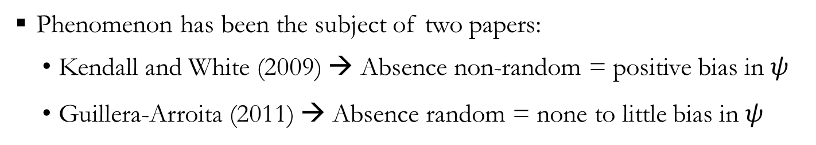





Survey Design: Spatial Replication
Model for Occupancy
$$z_{i}\sim Bernoulli(ψ_{i})$$
True State Process
Model for Detection
$y_{ij}\sim Bernoulli(p_{ij}×z_{i}$)
Observation Process
$$\acute{p_{ij}}=p_{ij}×θ_{ij}$$
where $p_{ij}$ is true detection and$θ_{ij}$availability for detection
When $θ_{ij}$ is nonrandom and unmodeled:
bias in $\acute{p_{ij}} and ψ_{i}$
Phenomenon has been the subject of two papers:
Kendall and White (2009) → Absence non-random = positive bias in $ψ$
Guillera-Arroita (2011) → Absence random = none to little bias in $ψ$

Slide 32
Design of Occupancy Surveys
Spatial Replication: A Lotic Perspective
Study Area
River Basin
Survey units
Habitat Sequences within stream segments
Survey 3
Survey 2
Survey 1
Inference regarding occupancy is at scale of the survey unit, here a pool-riffle-run sequence within a given stream segment.
Each survey represents a pool-riffle-run sequence.
Detection is the probability of detecting the species in a given pool-riffle-run sequence.

Slide 33
Design of Occupancy Surveys
Repeat Surveys
Main thing to consider is how the proposed design relates to model assumptions:
Closure/randomness
Independence
Heterogeneity

Slide 34
Design of Occupancy Surveys
General recommendations on effort allocation
Try to obtain p* > 0.80, p* = 1-(1-p)^{K}, where K represents the number of survey occasions and p represents the occasion-specific detection probability.
Depending on design and costs, generally wasteful visits when p* > 0.95.
For rare species, survey more units less intensively.
Increasing spatial replication with insufficient repeat surveys may not be worthwhile.

Slide 35
Design of Occupancy Surveys
Final Design Comments
Designing studies is generally an iterative affair
Simulation and pilot studies can provide useful information on how designs and field methods are likely to perform
GENPRES (linked at Presence webpage)
Simulate your own scenarios, preferably based on pilot data.

